Slide 1
Mathematical models for speed climbing applied to data collected on competitors in recent World Cup events
Luca Benga¹, Benjamin Hatch² and Dana Sylvan²
Hunter College High School ¹
Department of Mathematics & Statistics
Hunter College of the City University of New York ²
MATHSPORT INTERNATIONAL
LUXEMBOURG
JUNE 4-6, 2025

Slide 2
Outline
Historical Speed Climbing
Data
Methods
Results
Discussion

Slide 3
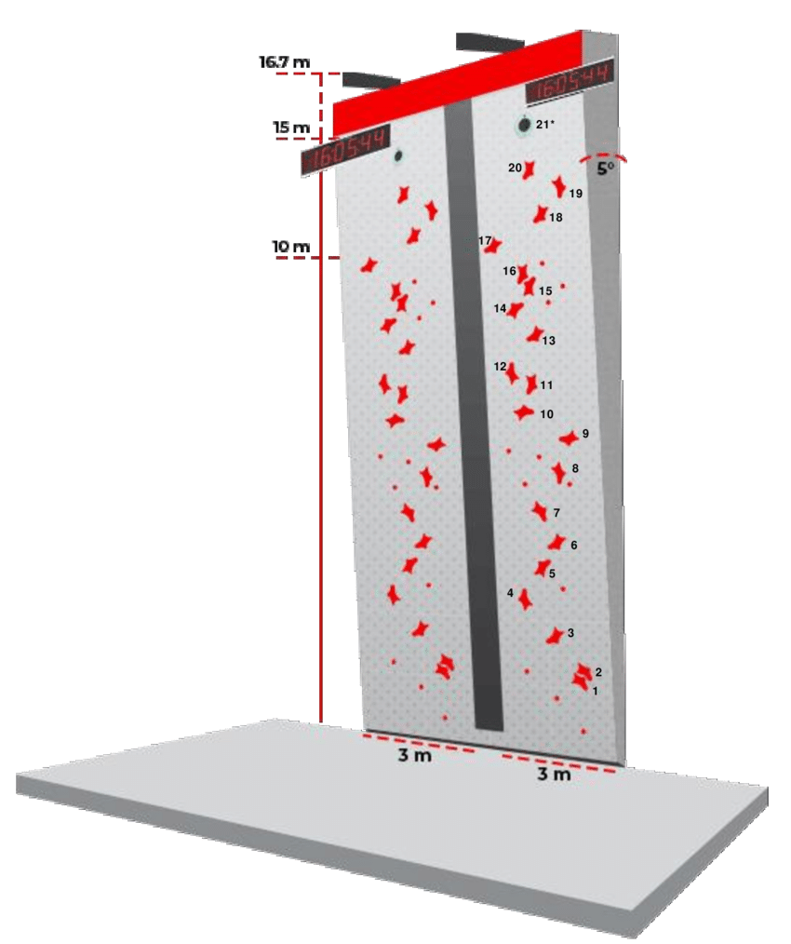
The Speed Climbing Wall
Exists in current form since 2007
15m high with 5° overhang
20 standard big holds an 11 foot chips
Two routes (A and B) with no difference
In World Cup qualifiers, each competitor has one run on each route
World record: https://www.youtube.com/shorts/pkFdPeqXI_w

Slide 4
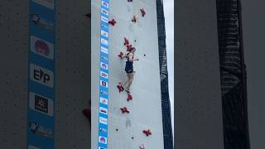

Slide 5
Technique and Other Performance Drivers
Skips: main way of improving performance is skipping holds
  Typical skips for most current male World Cup competitors are holds 4 (Tomoa) and 9.
  Most aggressive technique (WR holder Sam Watson) skips both 12 and 14.
Reaction time:
  Under 0.1s is considered false start and leads to disqualification
  Typical reaction is between 0.15 and 0.2s
Routes: A vs. B
Qualifying Runs: First vs Second

Slide 6
Data
A detailed dataset was compiled for the IFSC World Cup Wujiang 2024 and SLC 2024 qualification rounds (two runs for each athlete)
Starting list, athletes names, height, bib number and total time for both runs were obtained from the IFSC Results website
All other variables were collected using a detailed video analysis of the competition’s recording on IFSC’s Youtube channel (Speed qualifications | Wujiang 2024) as follows:
  Precision of estimate is ~0.03/0.04sec, given the time gap between frames.

Slide 7
Descriptives
Numerical Variables
  Time, Reaction Time, Time to Hold 10, Time to Hold 16, Time to Hold 20, Time w/o Reaction Time, Hold 0 to 10, Hold 10 to 20, Hold 20 to Top, Hold 10 to Top.
Categorical Variables
  Route (A/B), Use Hold 4 (1/0) , Use Hold 12 (1/0), Use Hold 14 (1/0)
All variables have separate values for Round1 (R1) and Round2 (R2)

Slide 8
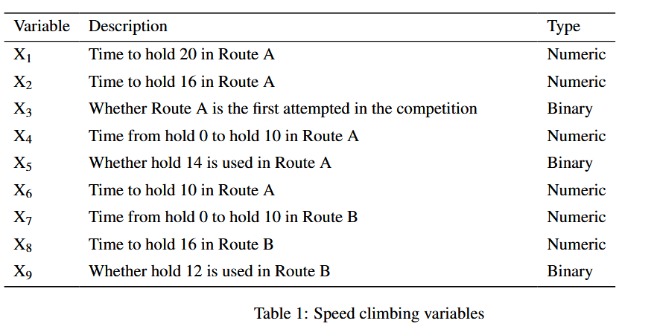
Variables
Notes:
Comment on obvious model -> target leakage…. list the two models one with 14 one a-> b

Slide 9
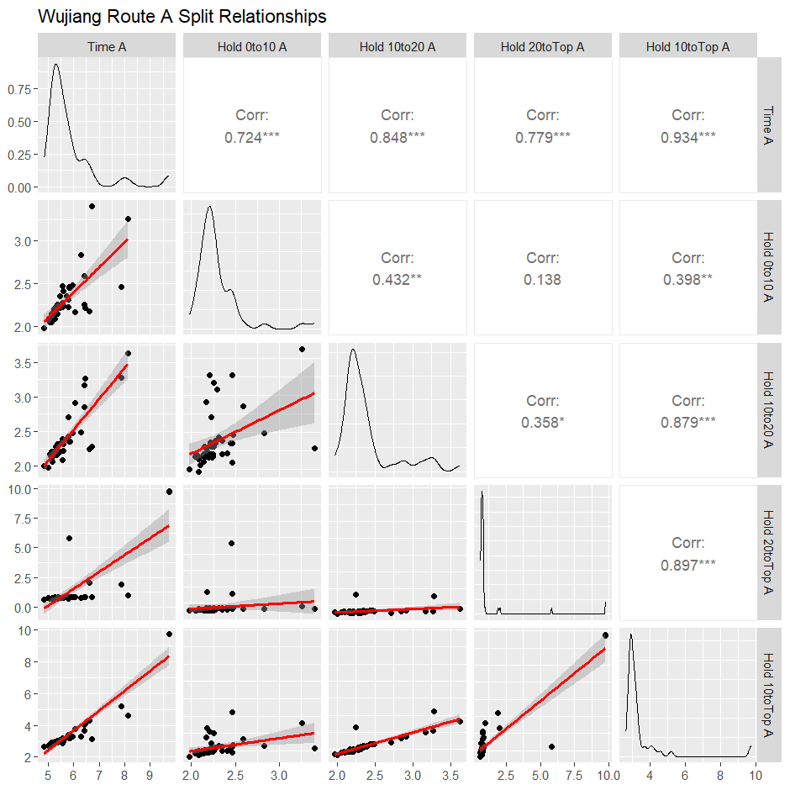
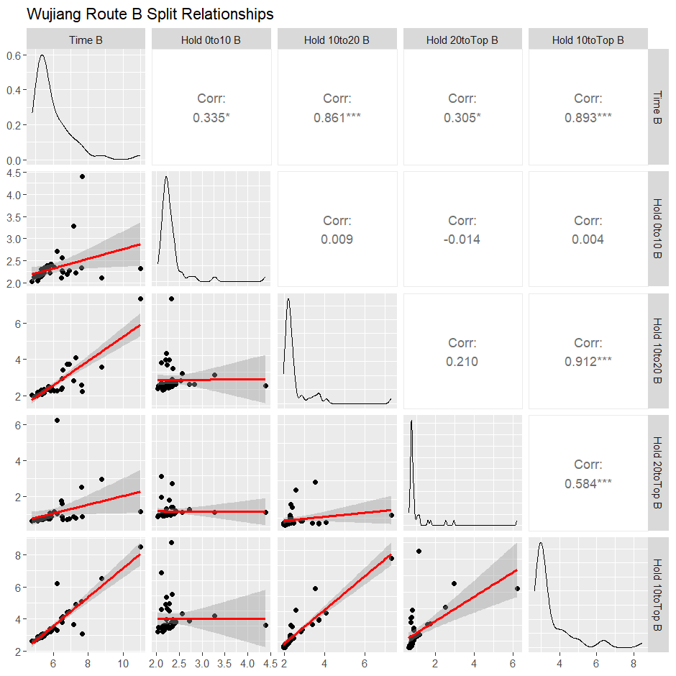

Slide 10
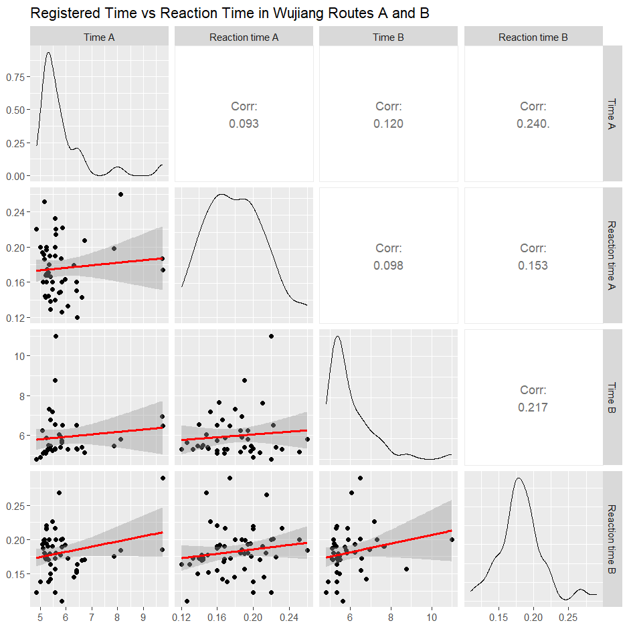

Slide 11
Methods
Classic linear models methodology
First model: Predicting current run time based on current run first half splits and hold strategy
Second model: Predicting current run time based on previous run splits and hold strategy
Interactions
Model selection

Slide 12
Results
First model: Predicting Route A run time based on Route A first-half splits and skip strategy (R² = .6443, RSE = .4428)
TimeA = 2.692 + .3624X₃ + 8.101X₄ − 2.688X₅ − 6.501X₆ + 1.208X₅X₆
Second Model: Predicting Route A run time based on Route B run splits and skip strategy (R² = .5545, RSE = .5005)
TimeA = −28.9977 − 12.0108X₃ + 15.3040X₇ + 8.4712X₈ + 1.6232X₉ + 5.5963X₃X₇ − 3.7545X₇X₈
Notes:
Comment on obvious model -> target leakage…. list the two models one with 14 one a-> b

Slide 13
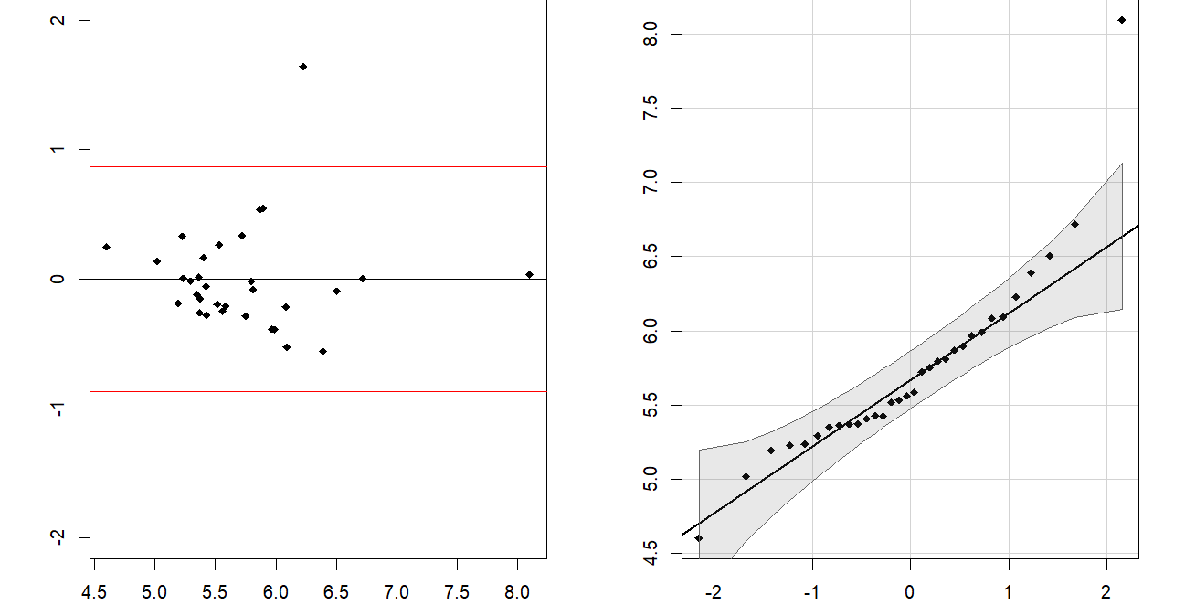
Diagnostics
Test case with Sam Watson: 1.25% off
Notes:
Comment on obvious model -> target leakage…. list the two models one with 14 one a-> b

Slide 14
Discussion / Findings
Reaction time has minimal impact on total time and is inconsistent between runs. “Good” runs (under 6s) have slower average reaction times, suggesting mental burden of fast reaction has detrimental effect on total time.
First-half split time (holds 0 to 10) has a significantly lower correlation to total time than second-half split time (holds 10 to 20). Starting strong remains important, but finishing strong is far more important.
Athletes take a more aggressive, but riskier skip strategy on the second run, yielding faster times but also more falls.
Notes:
Comment on obvious model -> target leakage…. list the two models one with 14 one a-> b

Slide 15
References
Speed Wall Image source:
Source: Lau, Emily. (2021). Identifying physiological demands of Speed Climbing within a sample of recreational climbers. 10.13140/RG.2.2.18266.06089.
Adapted from Walltopia Speed Walls brochure: https://cdn.walltopia.com/wp-content/uploads/20231027230235/Walltopia_Speed_Walls_Brochure.pdf
R. Pruim (2011). Foundations and Applications of Statistics. An Introduction using R. American Mathematical Society, Providence, Rhode Island
IFSC Results website: https://ifsc.results.info/event/1354/
IFSC’s Youtube channel (Speed qualifications | Wujiang 2024)

Slide 16
Thank you!

